Slide 1



Admin

Slide 2
Admin Intro

Slide 3
Welcome to Admin
During this Module you will learn how to work within the Administration Manager A.K.A. ADMIN.
Admin is where every department works from, using different managers to do so.
All client information and prescription information is stored here.

Slide 4
Welcome to Admin
ADMIN has four main managers that you will need to fully understand as a customer service agent. This will allow you to help any customer to your fullest capability.
Customer Manager
Order Manager
Rx Manager
Inventory Manager

Slide 5
Customer Manager

Slide 6
Customer Manager
Introduction
Customer Manager is where all customer information is stored. This is the customer's main account.
Here you can do the following:
Search for Accounts
Manage Account
Review Orders
Document Notes
Notes:
Transition Arrow Indicating Customer Manager Location

Slide 7
Customer Manager
Search for Accounts

Slide 8
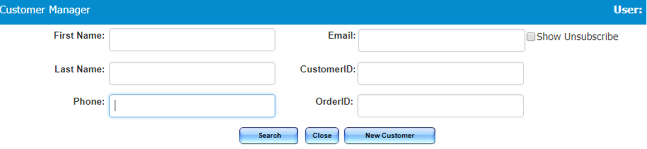
Customer Manager
Search for Accounts
Customer accounts can be accessed through the Customer Manager tab by entering any of the information requested below.
Specific, rather than general information must be entered in order to bring up the correct account.
Notes:
General Information
First Name ONLY
Last Name ONLY
Specified Information
Phone Number
Email Address
Cust- ID
Order- ID

Slide 9
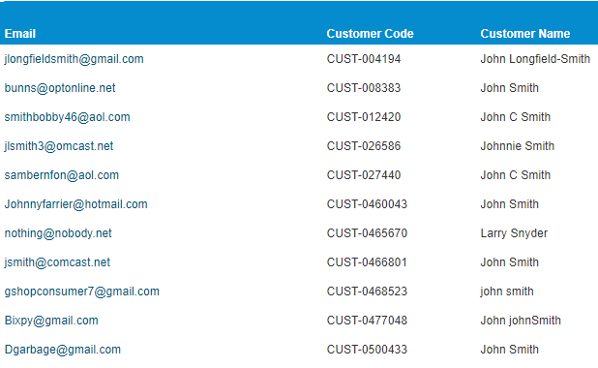
Customer Manager
Search for Accounts Cont.
General Information
Example: A customer calls in and advises you they have an account. They provide you with their first and last name “John Smith”.
As we have thousands of customers and this is a very common name, the list of all John Smiths with in our data base will be listed.

Slide 10
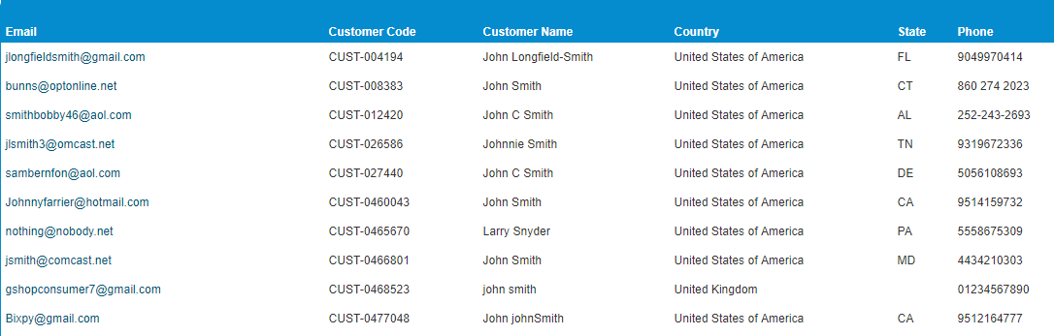
Customer Manager
Search for Accounts Cont.
General Information Example Cont.
Notes:
TRANSITIONS
At this point you will still be able to figure out which account belongs to your client.
You will need to narrow down the search by asking the client some questions
What is their email address? (TRANISTION 1)
What state they reside in?
What is their phone number?
TRANISTION 2

Slide 11
Customer Manager
Search for Accounts Cont.
Specific Information
Example: A customer calls in and advises you they have an account. They provide you with their first and last name “Agent Training”, and their telephone number “305-500-9944”
Their exact account should populate as shown to the right.
No additional information necessary.

Slide 12
Customer Manager
Tabs

Slide 13
Customer Manager
Tabs
Customer manager has six main tabs. However as a customer service agent you will only be working with five of them.
Customer
Billing Address
Shipping Address
Order History
Notes

Slide 14
Customer Manager
Tabs Cont.
Customer Tab
On this tab, the following information can be added or edited:
Customer's email address
Password
Name on account
Notes for the customer to view can be added
Notes for internal purposes only can be added
You can also manage what the account qualifies for

Slide 15
Customer Manager
Tabs Cont.
Customer Tab
Customer Notes
This is where you would place any notes that should be seen immediately when entering the account
EXAMPLE:“ESCALATED CUSTOMER, be sure to verify everything”
Notes:
TRANSITION
Indicates where cust notes is located

Slide 16
Customer Manager
Tabs Cont.
Customer Tab
Private Order Notes
This is where you would place any notes that you or the customer wants on their account permanently.
Customers can view these notes as they are printed on the shipping labels.
Indication of reward point usage for autoship orders.
These notes MUST include the word “REWARD”
Notes:
TRANSITION
Indicates where private order notes is located
Example of Permanent Notes
Brand Preference
Additional Contact Info
Packing Instructions

Slide 17
Customer Manager
Tabs Cont.
Customer Tab
Other Settings
Allows you to activate or deactivate the following:
Active
Subscribed
Reward Points
StorePickUp
Export
IsVet
Notes:
TRANSITION
Indicates where other settings is located
Settings
Active
- Indicated if the account is active or deactivated
Subscribed
Will allow the client to receive email promotions
Allows clients to be updated regarding the status of their order
Reward Points
Indicates the account qualifies for the reward program
StorePickUp
Indicated that the client is eligible for store pick ups
Export
Will allow client to purchase export only items
IsVet
Indicated the client is a licensed veterinarian

Slide 18
Customer Manager
Tabs Cont.
Billing Address Tab
Billing address can be added or edited here
A “Residence Type” must be selected to save any changes made to the account
You can copy the billing address to the shipping address by checking the box at the bottom

Slide 19
Customer Manager
Tabs Cont.
Shipping Address Tab
Customer shipping address can be added or edited here
NEVER update a shipping address from here if there is an open order.
A “Residence Type” must be selected to save any changes made to the account.
You can make this address the primary address by checking the box at the bottom
Notes:
If you change an address for an open order within the customer manager, this will NOT sync to the order.
Orders are generated and placed as is, it will not automatically update.
EXAMPLE: If you send a text to your friend, and realize that they got a new phone and a new phone number but you haven’t updated your contact information yet.
- Will that text be sent to them now that you have updated their contact information?
- NO!
- You need to send that message again to the correct phone number.
This works the same way with updating a shipping address on an open order.

Slide 20
Customer Manager
Tabs Cont.
Shipping Address Tab
You can manage and edit any other saved shipping addresses from here.

Slide 21
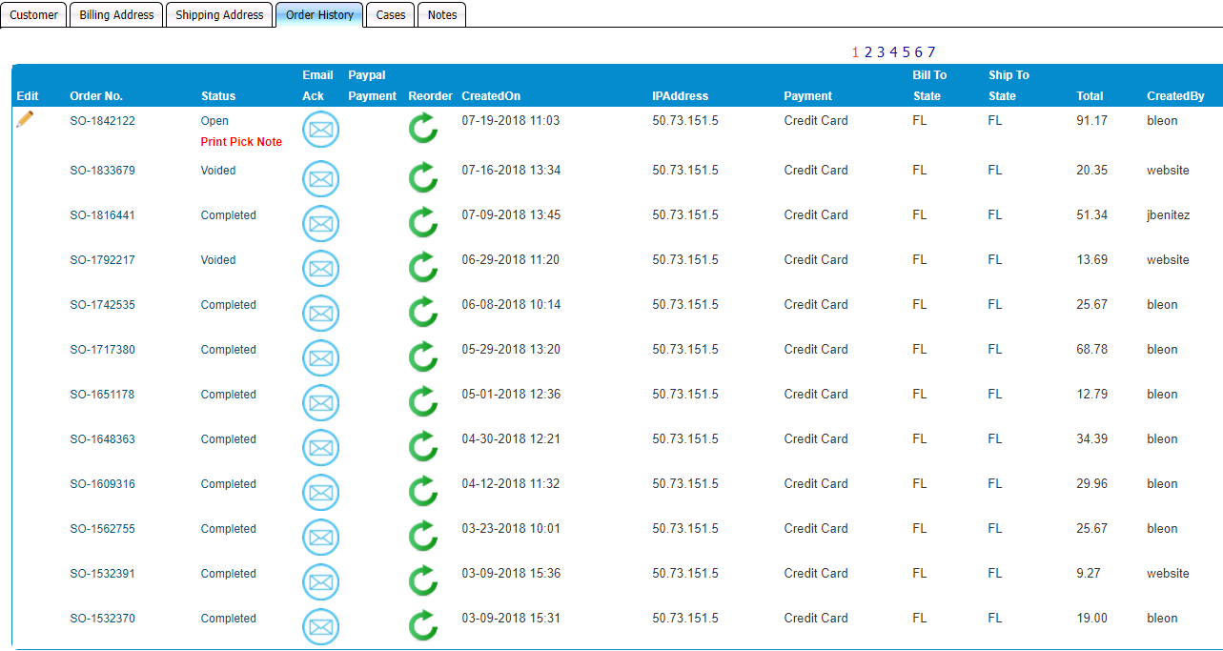
Customer Manager
Tabs Cont.
Order History Tab
Notes:
Here you can view all of the clients passed orders along with any open orders
You can also send clients email notices of their
Order Acknowledgement
Order Invoice
You can create a reorder for the client
You can void orders
Verify
Order Number
Order Status
Order Creation Date
IP Address
Payment Methods
Bill to and Ship to State
Total
How the Order Was Created

Slide 22



Customer Manager
Tabs Cont.
Order History Tab
Image | Meaning
 | Email Notice Button
 | Reorder Button
 | Void Button
 | Edit Order Button
Notes:
Make sure to advise agent not to void order using the "void button"
To cancel an order it must be voided inside the order
- Notes must be put in the E-COMMERCE NOTES
-Save
- Void Order

Slide 23
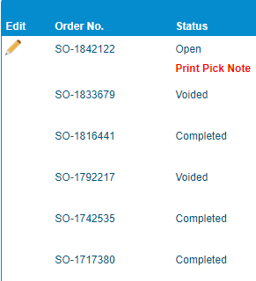
Customer Manager
Tabs Cont.
Order History Tab
Edit: Pencil is a direct link into the open order.
Order No: Is a hyperlink to view the order acknowledgement.
Status: Is a hyperlink to view the order report and allows you to enter prescription card of an Rx item on the order.

Slide 24
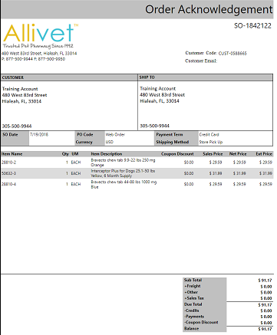
Customer Manager
Tabs Cont.
Order History Tab
Order No. : Is a hyperlink to view the order acknowledgement.
Once you click on the order number it will redirect you to:

Slide 25
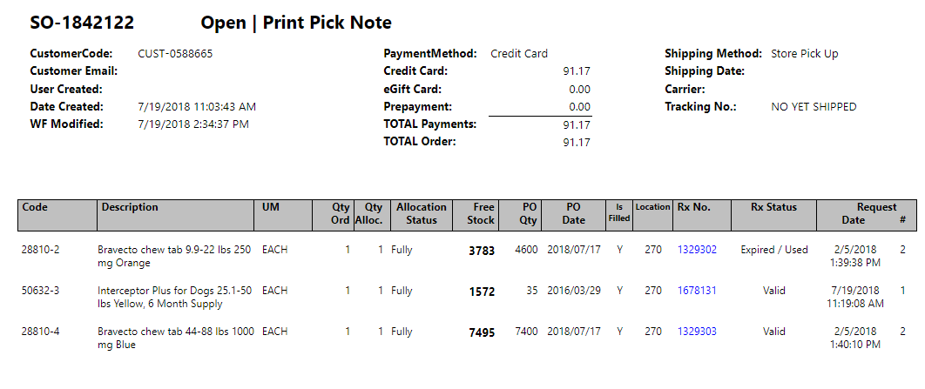
Customer Manager
Tabs Cont.
Order History Tab
Status: Is a hyperlink to view the order report and allows you to enter the prescription card of an Rx item on the order.
Once you click on the status it will redirect you to:
Notes:
Instruct this report can also allow them to see tracking information including carrier and when it was shipped
Informed if there is an outstanding balance it will reflect on here
How many in stock will reflect on here

Slide 26
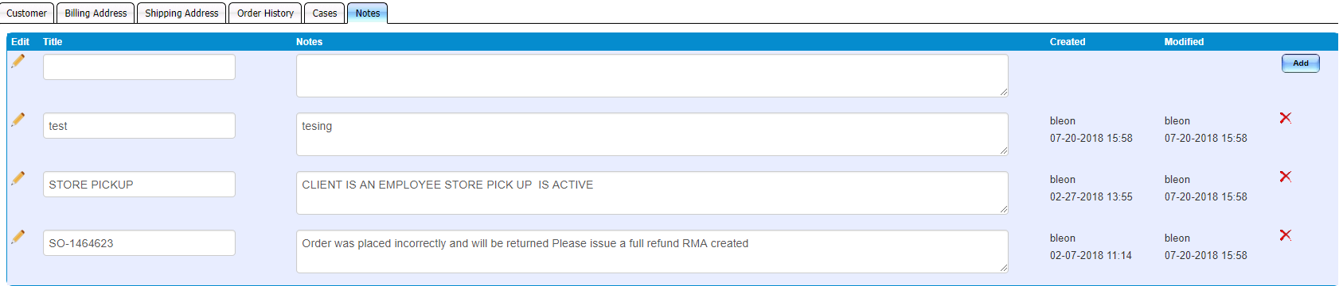
Customer Manager
Tabs Cont.
Notes Tab
Here you can add detailed notes on any interaction with a customer.
All notes are automatically time stamped and will include agent name
Notes need a Title before they are saved.
Notes:
Titles- should include order number

Slide 27
Customer Manager
Radio Buttons

Slide 28
Customer Manager
Radio Buttons
Customer manager has thirteen different radio buttons to allow you to easily move through the customer's account.
Many of these buttons work the same way as the customer account does via the website.
Some buttons are only accessible to you as a customer service agent.

Slide 29
Customer Manager
Radio Buttons Cont.
Simple Buttons
Save: MUST click on this button for any changes or notes on the account to be saved
Close: Do NOT click unless you have saved all your notes or updates.
Credit Cards: You can view, add, or remove different credit cards on file
Pets: You can edit, add, or merge the customer's pet profiles.
Vets: You can edit, add, remove, and search through our directory to find a vet for a customer.

Slide 30
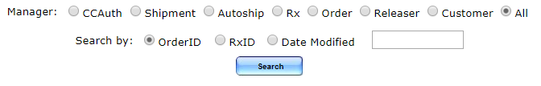
Customer Manager
Radio Buttons Cont.
Audit Trail Button
This button provides a history of who has accessed the account and what was done.
ALWAYS search from a day or two prior to the actual date the order was placed on.
Anything under WEBSITE was created online via the client.

Slide 31
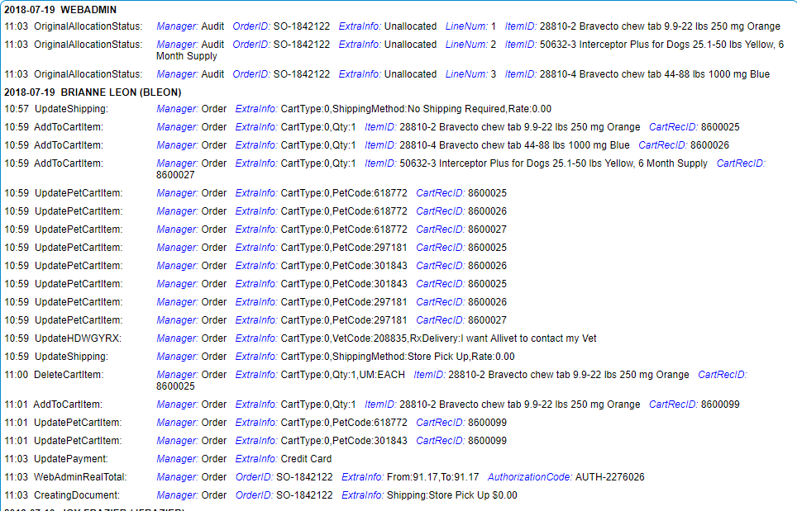
Customer Manager
Radio Buttons Cont.
Notes:
TRANSITIONS
Square 1 = Location of agent who entered the account
Square 2 = Location of what they did
Square 3 = Specified details of what they did

Slide 32
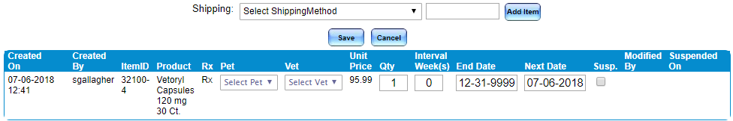
Customer Manager
Radio Buttons Cont.
Autoship Button
View any active or suspended autoshipments
View when it was created and by whom
View who was the last person to modify an existing autoshipment
Edit or suspend autoshipments
Create an autoshipment
Notes:
Additional Information
You can not delete an autoshipment from the clients account
Client is the only one that can remove an autoshipment from their account
If pet or vet info is not entered the autoship will not generate

Slide 33
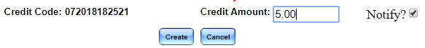
Customer Manager
Radio Buttons Cont.
Store Credit Button
All store credits can be added or viewed on here.
When adding a store credit, an email can be sent to the customer with the coupon code.
The maximum store credit allowed is $25.
Anything over $25 will need to be added by a manager.

Slide 34
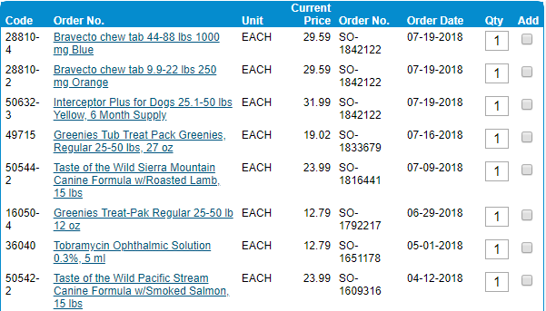
Customer Manager
Radio Buttons Cont.
Items Button
All items purchased by a customer can be viewed here.
Sorted by:
Item Number
Item Name
Unit Sold
Current Price
Order #
Last Order Date
Notes:
QUICK TIP
Although there is a QTY and an Add box these features will not be added to the cart.
- This feature is included within the Order Manager and works from there

Slide 35
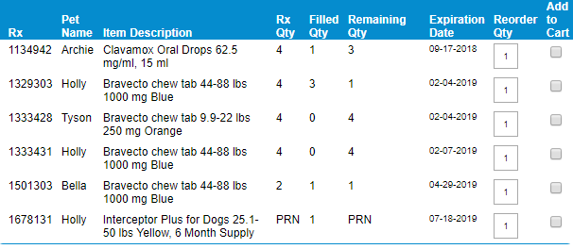
Customer Manager
Radio Buttons Cont.
RX Button
All valid prescription(s) the customer has on file can be viewed here.
Unlike the customer portal, you can ONLY view what is currently valid.
Sorted by:
RX No.
Pet Name
Item Name
RX QTY
Filled QTY
Remaining QTY
Expiration Date (EXP Date)
Notes:
QUICK TIP
Although there is a QTY and an Add box these features will not be added to the cart.
- This feature is included within the Order Manager and works from there

Slide 36
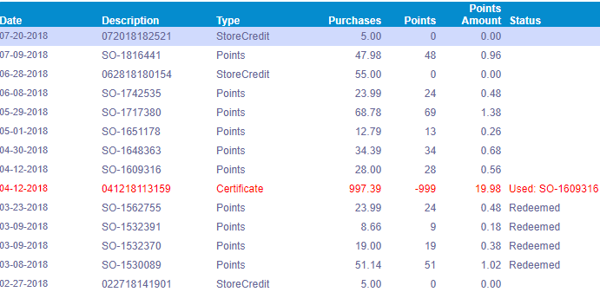
Customer Manager
Radio Buttons Cont.
Points Button
View and redeem store credits and rewards here.
Divided by the points accumulated per individual order.
Store credits will appear here and will reflect the order they were used on.
Notes:
Minimum of 250 points to generate certificate
Certificate will expire within 30 days of issue

Slide 37
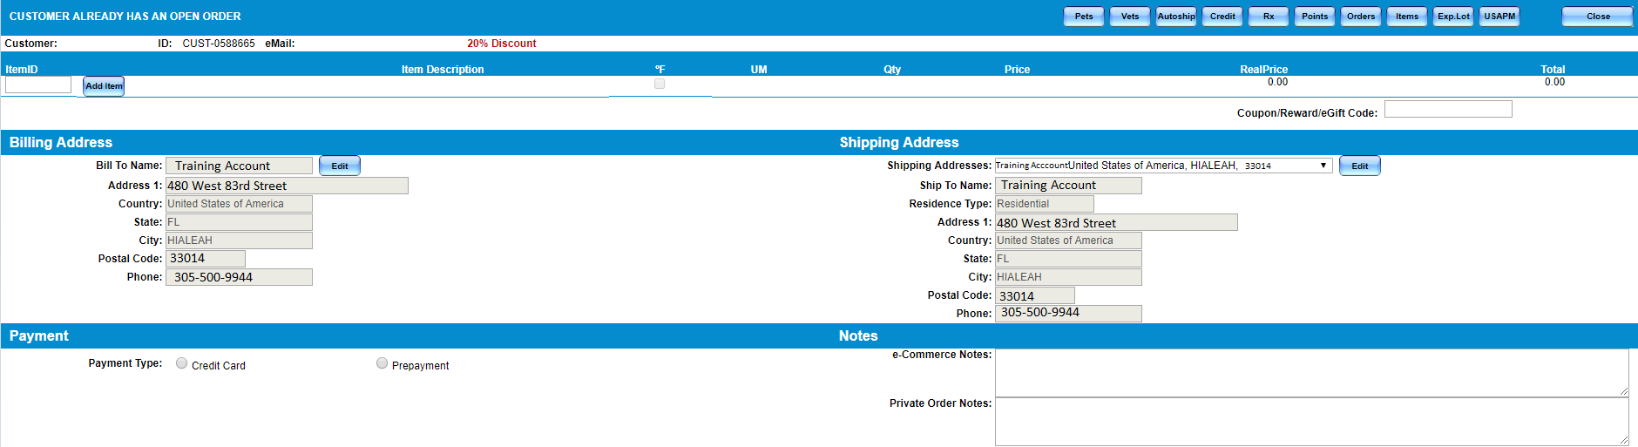
Customer Manager
Radio Buttons Cont.
Create Order Button
Notes:
This is where all orders are placed.
This can be done from both the Customer and Order Managers.
You will need to specify a customers account prior to creating an order.

Slide 38
Customer Manager
Radio Buttons Cont.
Create Order Button
Notes:
TRANSITIONS
There are Radio Buttons in the Order manager as well as in the Customer manager (Transition 1):
Pets
Vets
Autoship
Credit
RX
Points
Orders
Items
These are all buttons that you have seen before through the client portal on the website and through the customer manager.
You will enter the item number of the items the client is looking to add to the order in the box to the left and click on the blue “ADD” button to place the item on the order (Transition 2)
Be sure that you are always confirming the client’s billing and shipping address prior to completing their order (Transition 3)

Slide 39
Customer Manager
Radio Buttons Cont.
Create Order Button
Notes:
TRANSITIONS
After adding your item and clicking “ADD” you will then be able to make the following adjustments:
QTY (Transition 1)
Specify a Pet if RX (Transition 2)
Specify a Vet if RX
Specify how the RX is going to arrive to us if RX (Transition 3)

Slide 40
Customer Manager
Radio Buttons Cont.
Create Order Button
Notes:
TRANSITIONS
If we are covering shipping, agent must $0.00 shipping box and check the box
Notes must be put on e-commerce if we are covering expedited shipping
Once all the items have been entered and you have confirmed the QTY and items with the client you may click on
the blue button “Shipping & Total” (Transition 1)
Here your total will populate.
For an accurate total you will want to confirm the select shipping method the client prefers from the
dropdown menu (Transition 2)

Slide 41
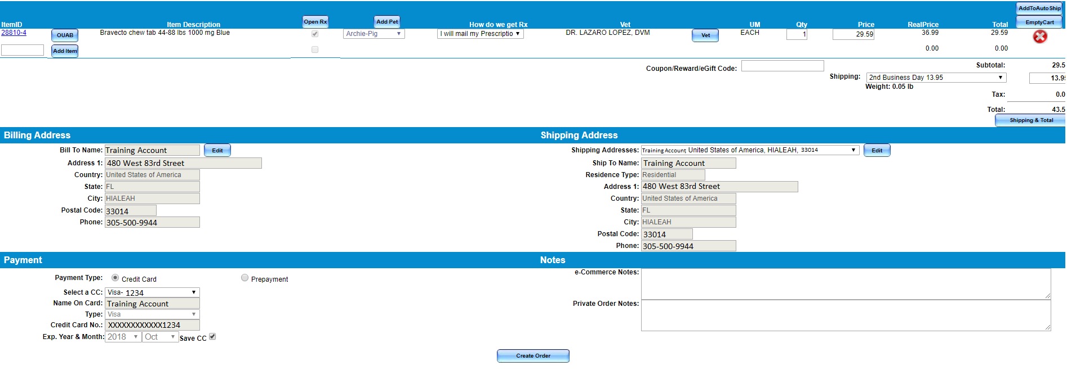

Customer Manager
Radio Buttons Cont.
Create Order Button
Notes:
TRANSITIONS
After all billing and shipping information have been confirmed, you will need to confirm or collect a form of payment (Transition 1)
You have two options:
Credit Card
Prepayment
Prepayment
This is for clients that qualify for store pick ups that would like to pay with cash upon their arrival
Once the payment method has been decided on and entered, all that is left is to finalize the order
- You will need to click the blue button “Create Order” (Transition 2)

Slide 42
Order Manager

Slide 43
Order Manager
Introduction
Customer order history can be found on the Order Manager.
Here you can:
Search previous orders
Search existing orders
Create Reshipments
Review Orders
Create New Accounts
Notes:
Transition Arrow Indicating Order Manager Location

Slide 44
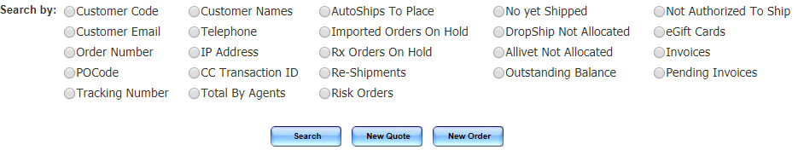
Order Manager
Search Engines
Order manager houses any order that has ever been placed with Allivet.
There are a variety of ways to locate an order, including general and specific searches.
As a Customer Service agent you will primarily work with the first two columns, and two more fields within the third column.
Autoships to Place
Risk Orders

Slide 45
Order Manager
Search Engines
General Search
Notes:
TRANSITONS
General Search
When using a general search field you will be able to populate all the orders placed under that form of information.
Example: when searching under a Telephone (Transition 1) you will see all the orders ever placed using this telephone number will populate (Transition 2).
This provides a more cluttered results area.
General Search Fields:
Customer Code
Customer Email
Customer Names
Telephone
IP Address

Slide 46
Order Manager
Search Engines
Specific Search
Notes:
TRANSITONS
Specified Search
When using an unspecified search field you will be able to bring up all the orders placed under that search field.
Example: when searching under a phone number (Transition 1) you see all the orders placed using that phone number (Transition 2)
Specified Search Fields:
Order Number
PO Code
Po codes are used as reference codes for our Vetdepot orders (More about VD in Module 7)
Tracking Number
When using any kind of order number it is important you understand the differences in orders
SO= Sales Order
AS= Autoship Order
VS= Vetdepot Order

Slide 47

Order Manager
Search Engines
AutoShips to Place
Reflects Autoship orders that were unable to process due to an error.
Risk Orders
Reflects orders flagged by the system as potentially fraudulent.
These orders need specific information confirmed by the customer prior to being released.
Notes:
TRANSITIONS
Transition 1= Autoship to Place location
Transition 2= Risk Order location

Slide 48
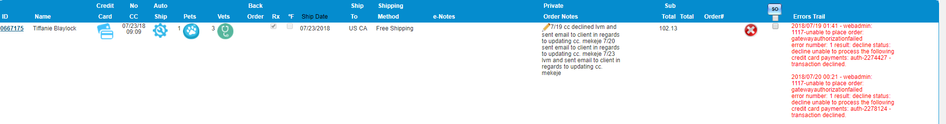
Order Manager
Search Engines
AutoShips to Place
Autoship errors will reflect on the right-hand side in red. These errors can be a result of:
Deceased Pet
Declined CC
P.O. Box Listed
Same Pet/ Same Item
No CC
Reward Points
Notes:
Additional Information
All orders that are listed with Autoship errors have a three day time frame to be corrected by the client.
Clients are contacted via email and phone call as an error notification and advised that their order has yet to be created due to said error.
Should the client not recontact us by the third day this order is cancelled.

Slide 49


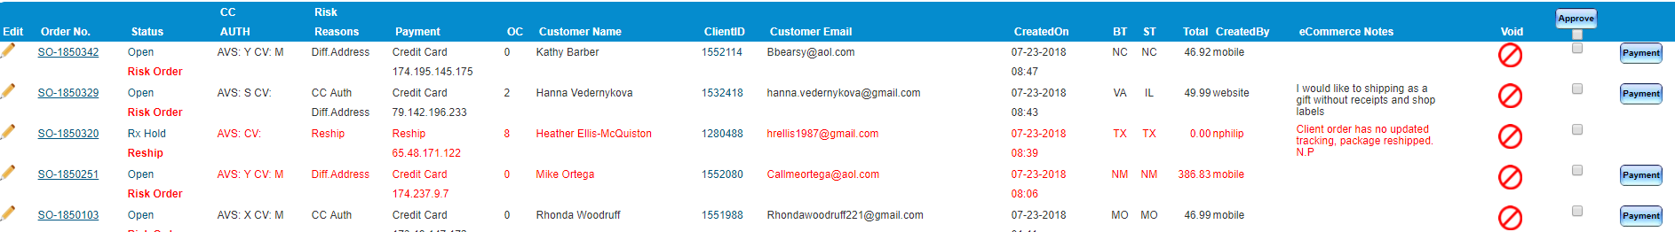
Order Manager
Search Engines
Risk Orders
Reflects orders flagged by the system as potentially fraudulent.
These orders need specific information confirmed by the customer prior to being released.
Duplicate Orders
CC info not matching
Billing and Shipping are Different
Small Charge Verification
Notes:
TRANSITIONS
Additional Information
All reasoning would be listed to the left hand side under “Risk Reason” (Transition 1)
Clients are contacted daily via a phone call advising of the order being placed on a Hold until we have verified the correct information.
Once the information has been verified the order will be approved by the agent working on this tab.
Notes have to be placed in the Ecommerce Section of the order in order for the order to be approved (Transition 2)
Small Charge Verification- Apply to orders more than $500

Slide 50
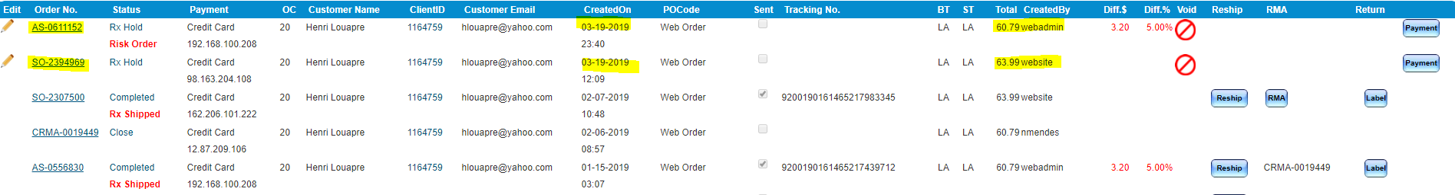
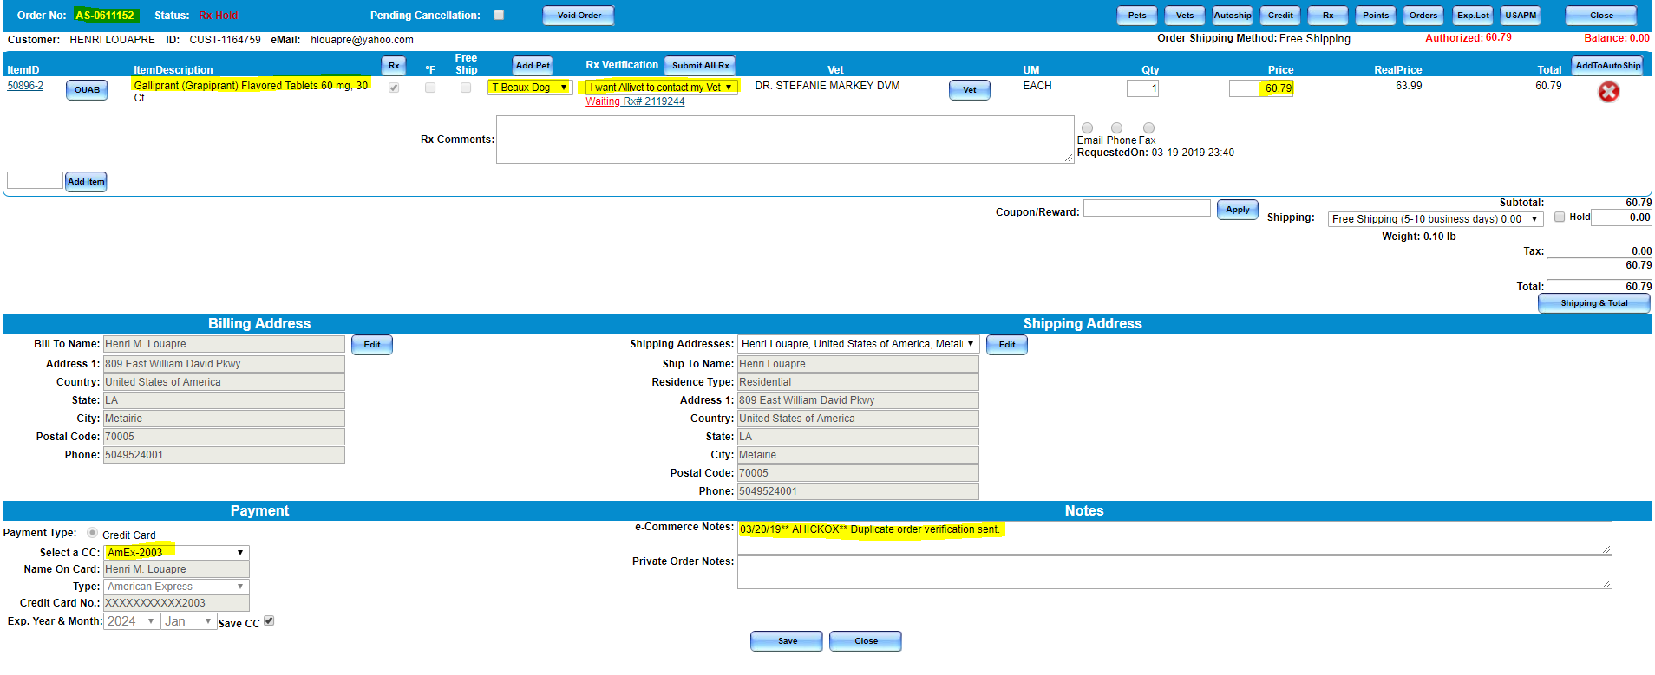
Order Manager
Risk Order
Notes:
- When a standard order is placed and an autoship order generates, it will be marked as a risk order. It will show as duplicated
- Risk analyst will reach out to the customer to confirm if both orders are needed

Slide 51
order Manager
Statuses

Slide 52
Order Manager
Statuses
Status | Meaning
RX Hold | There is a hold due to pending prescription authorization.
Open | Orders can still be adjusted prior to shipping
Open Print Pick Note | Label is ready to be printed by the warehouse for packaging.
Open Ready to Invoice | Invoice has been printed by the pharmacy and is waiting to be packaged by the warehouse.
Voided | Order has been cancelled.
Completed | Order was either shipped out or picked up from our facility.
Notes:
Open ready to invoice and Completed- order has been shipped and we are no longer able to make any adjustments or cancel order

Slide 53

Order Manager
Statuses Cont.
Rx Hold
Rx Hold has several different meanings. You MUST view the RX Card in order to get the specific reason.
Rx Hold can be due to:
Rx missing vet approval
Issue with approval
Out of stock item
Waiting on client confirmation regarding an issue
Approved waiting to be filled

Slide 54
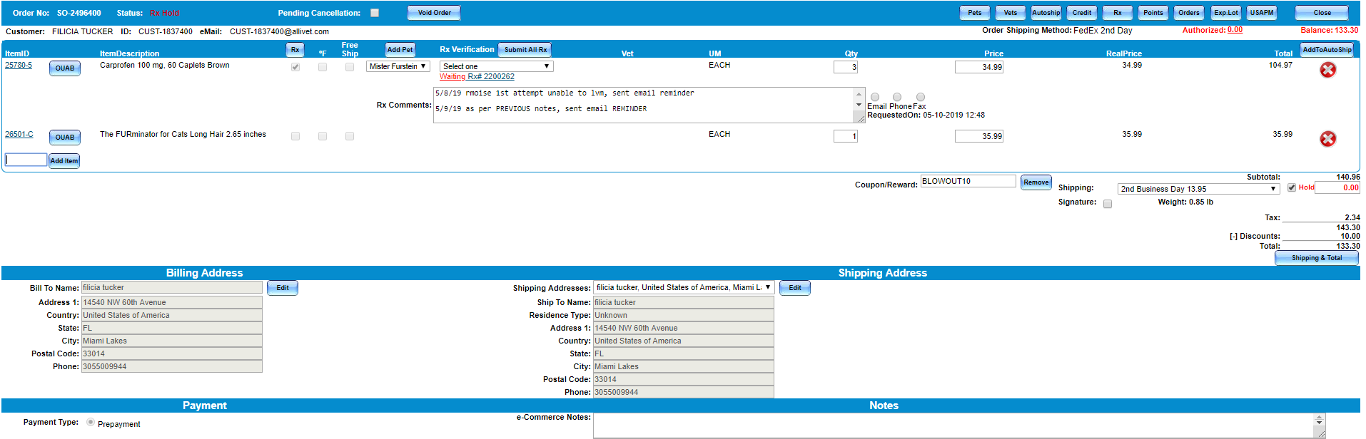
Order Manager
Cancel Order
Notes:
If a customer request to cancel an order they must edit order.
- Once they open pending order, they must put notes on e-commerce on why customer requested to cancel order
- After they will click on VOID ORDER at the top
Orders that have been voided prior to being shipped it is not a refund that reflects on the account. This is since charges are only held at the time an order is placed. Once an order has been shipped from our facility is when this charge becomes a completed charge.

Slide 55
order Manager
Price Quote

Slide 56
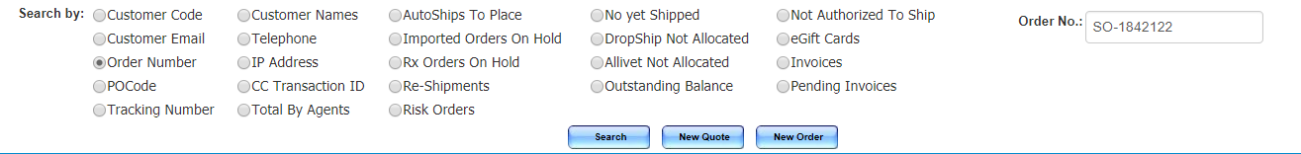
Order Manager
Price Quote
We do not always have individual customers calling in to place orders. Sometimes we have large vet offices, or universities calling in to place orders.
Typically these kind of calls need to have a price quote made.
Here you will create the quote as if you were creating an order.
Notes:
TRANSITION of New Quote Location
Advised if it is a university calling to place an order, they must be advised a vet approval is needed

Slide 57
Order Manager
Price Quote
When you are making a quote you need to ask if they have an existing account
If they do not, you will need to create an account for them.
You can search for an account using the search fields on the right.

Slide 58
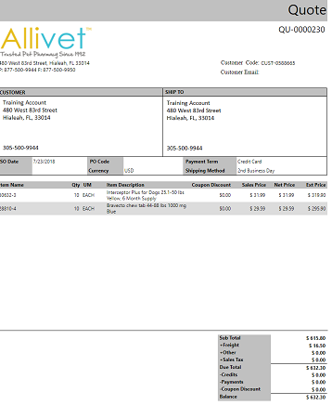
Order Manager
Price Quote
Once you have the account you will be redirected to the order page where you will proceed as if this were a regular order being placed.
After the quote has been made the client will be emailed a copy the quote.
This would be the equivalent to an order acknowledgement should it have been an actual order.
Quotes are saved but they cannot be converted into orders.

Slide 59
order Manager
New account

Slide 60
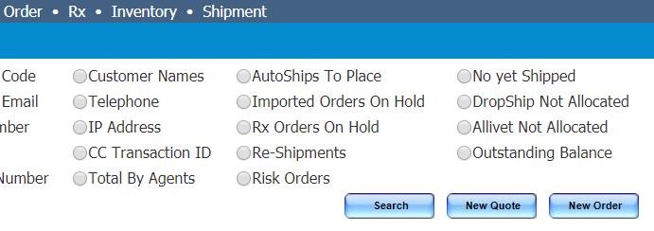
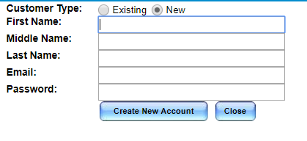
Order Manager
Create a new account
An agent will need to visit order manager in order to create a new account for a customer.
Notes:
-When a customer is calling in for the first time- a new account must be created !
- Open order manager
- Select new order
- Customer type as "NEW"
- Fill in the blank search fields
Temporary password is : 12345

Slide 61
order Manager
Specifics

Slide 62
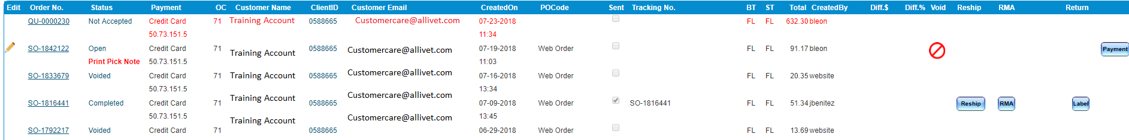
Order Manager
Specifics
There are certain things that can only be created in Order Manager:
Reshipment
Create a Return Label
Notes:
We no longer create RMA's

Slide 63


Order Manager
Specifics
Reshipments
Notes:
TRANSITIONS
Reshipments are typically made when something is wrong with the clients order, or the order shows that it was delivered and the client is stating they have yet to receive their order.
Reshipments do not have to be made from the entire original order, they can be adjusted.
When creating a reshipment you must keep in mind this is something the client has already paid for.
We want to be sure that all cost are reflecting “$0.00” (Transition 1)
Should there be any RX items within the reshipment, you want to make sure that you select “I will Mail” and change the vet office to our office.
If this is not done we are going to be contacting the vet for a prescription that the vet has already authorized.
WE DO NOT NEED ANOTHER APPROVAL
Should the client have valid refills on the prescription you will want to notify the pharmacy team via email that this is a reshipment and for them to have the refill added back onto the prescription for future use.
After the order has been adjusted you will need to select a shipping method and confirm this is also at $0.00 (Transition 2)
Keep in mind that client has already waited their initial shipping time frame, so you want to be sure that this order is being expedited.
As a Customer Service agent it will be up to you to decide what kind of shipping method is selected for the reshipment.
We ENCOURAGE you to make your own judgement calls.
Before your reshipment can be finalized, you will need to select a reason as to why you are reshipping this clients order (Transition 3)
You will have a dropdown menu with all the different reasons for a reshipment.
Once selected this will create an auto populated note in the ecommerce area as to why you are creating a reshipment.
Please be sure to NOTE the date and your name on the note.

Slide 64
Order Manager
Specifics
Reshipments
Reasons for creating a reshipment:
Wrong Item Received
Missing Item
Defective/Damaged Item
Expired Items
Package Lost In Transit
No Tracking Updates
Package Not Delivered
Package Shipped to Incorrect Address
Package Delayed
Notes:
Wrong Item Received
You want to be sure that you are advising which item was received and which item was not received so a proper return label can be issued to the client
Defective/ Damaged Item
Make sure an email is sent over to the escalations team to be sure that there are not any additional packing precautions that could be taken
Expired Items
Before creating a reshipment you will need to have the Escalations team confirm that we have further EXP dates for use.
Package Lost in Transit
Any order that has had no tracking update for more than 5 business days can be reshipped.
No Tracking Updates
-Any order that has had no tracking update for more than 5 business days can be reshipped.
Package Shipped to Incorrect Address
- Always confirm the new shipping address while creating the reshipment

Slide 65
Order Manager
Specifics
Return Shipping Labels
Return Shipping Labels (RSL) are issued to clients who wish to return items that have been unopened/unused.
These labels are all emailed to the client unless specified otherwise.
All RSL’s are created using FEDEX Ground shipping. This will automatically be preselected for you.
If address contains a PO BOX, service selected must be USPS Priority
Notes:
TRANSITIONS
Transition 1= Location of shipping method indicator
The address on the return label cannot be edited

Slide 66
Order Manager
Specifics
Return Shipping Labels
When creating a reshipment you want to be sure that your weight is correct otherwise the customer will be asked to pay postage.
When entering the QTY of the amount of items returned, be sure that you confirm before you click on the blue “CREATE RETURN LABEL” button.
Notes:
TRANSITIONS
Transition 1= Location of QTY
Transition 2= Location of weight
A return label must be created for all items on the order

Slide 67
rX Manager

Slide 68
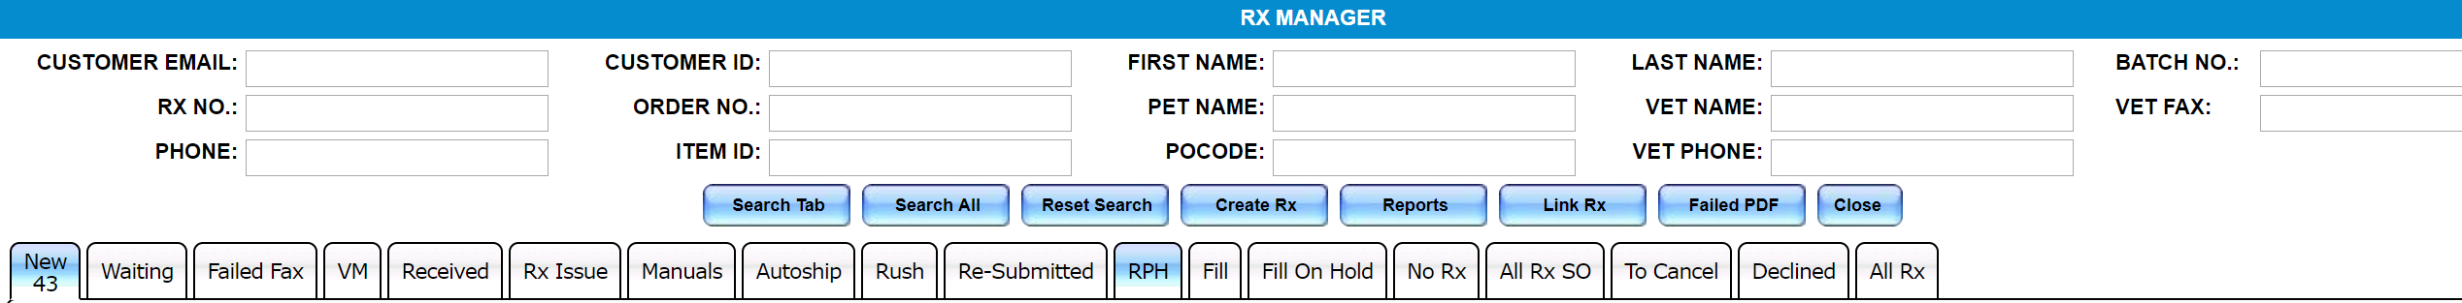
rx Manager
Introduction
Rx Manager is the primary manager which our pharmacy department works in. This is also where you as a Customer Service agent will need to pay close attention as many of our customer's questions will be based off their prescription orders and what their current status or issue may be.
Here you will learn to:
Search for prescriptions
Understand what the tabs are for
Read what the Rx Card is telling you

Slide 69
rx Manager
Search

Slide 70
RX Manager
Search
A search through RX manager needs to be very specific, but you may only have limited information to work with.
With Rx manager you not only have a variety of different search fields, you also have a variety of different tabs where your prescription may be housed.
Entering as much information as possible will allow you to narrow down the search as much as possible.
Notes:
Example:
If you have a client advising you that their vet has already called in the approval, and you can not locate said approval through her account you will need to run a search through the RX manager.
Step 1: Collect as much information as possible
- Ask what pet this is for?
- Ask what medication was prescribed?
- What her vet office phone number is?
All this information will allow you to enter the answers in the following search fields:
Pet Name (TRANSITION 1)
Item No (TRANSITION 2)
Vet Phone (TRANSITION 3)
Step 2: You will want to run the search through all the tabs as this will save you some time rather then having to click through each tab one by one.
- Click on the blue button that says “Search All” (TRANSITION 4)
Step 3: Chances are you will be able to locate the clients prescription if it has already been entered into the system using this method.
- If you were unsuccessful, you may need some additional help from our pharmacy team.
- If so please contact the Escalations Team and they will work with the pharmacists to locate the prescription.

Slide 71
rx Manager
RX CArd

Slide 72
RX Manager
RX Card
Notes:
Transitions
The RX card is the primary area that both he pharmacy and Customer Care work from.
This is where you will be able to identify if there are any issues regarding a customers prescription order.
The Rx card is broken up into different sections
Client Contact and Order Information (Transition 1)
Pet Profile (Transition 2)
Vet Information (Transition 3)
Date Created and Last Modified (Transition 4)
Form of Contact Area (Transition 5)
Pharmacy Status (Transition 6)
Comments (Transition 7)

Slide 73
RX Manager
RX Card
Notes:
Transitions
The Rx card also has radio buttons which will allow you to easily attach verbals/voicemail authorizations or PDF forms of the prescriptions (TRANSITION 1 and 2)
You can also mark a prescription declined by clicking on the blue button at the top of the RX card (TRANSITION 3)
Last button is the Rx Issue button which can be clicked in on when there is an issue with the prescription (Transition 4)

Slide 74
rx Manager
tABS

Slide 75
RX Manager
Tabs
There are a total of 18 tabs within the Rx manager. Clicking on the tab will display the number of Rxs within that tab.
Tabs:
New: New prescriptions with no veterinary fax information. These orders will need to be manually contacted for us to either obtain a fax number to the office or a verbal authorization.
Waiting: Prescriptions waiting to be authorized by the veterinary office.
Failed Fax: Faxes which failed to be transmitted to the veterinarian's office.

Slide 76
RX Manager
Tabs
Tabs:
VM: Any verbal authorization which has been recorded by one of our technicians will appear here for our pharmacists to review.
Received: Any prescription which has been received and linked to an order will be moved to this tab for review. It will then be sent to RPH Review or be validated by a pharmacist.
RX Issue: Prescriptions with errors found by pharmacists, will appear here. If the product or products ordered do not match what the veterinarian prescribed, the pharmacy team will mark them as Rx Issue. The client will have to be contacted before we can make any changes.

Slide 77
RX Manager
Tab
Tabs:
Manuals: Any order that needs to be manually followed up on regarding a prescription approval.
Autoship: Any autoship order that needs to be manually followed up on regarding a prescription approval.
This is a high priority tab and must be completed by the end of the day.
Rush: All orders which have been placed with expedited shipping
Re-Submitted: Our pharmacist will review the prescription. If it has been entered incorrectly our pharmacy technician will need to review it.
Notes:
Re-Submitted- If our pharmacy tech enters the directions incorrectly, it will be resubmitted by the pharmacist:
Example: typed incorrectly, missing refills, incorrect vet, or incorrect pet. etc

Slide 78
RX Manager
Tab
Tabs:
RPH: Orders that have prescriptions attached and are awaiting review by the pharmacists for validation.
Fill: All orders that have been filled by production and have been assigned a bin location.
Fill On Hold: Any prescription that has been validated and has an error or there is not enough stock to fulfill order
All Rx SO: Specifies which order the prescription has been used on and how many times it was used.

Slide 79
RX Manager
Tab
Tabs:
To Cancel: Three manual attempts will be made to get the prescription authorized, if no response received, Rx will be marked pending cancellation and it will appear here.
Declined: Any order which has been declined by the prescribing veterinary office can be found here.
All Rx: All prescriptions a customer has obtained or attempted to obtain will be in this tab and will include declined, expired/used and valid.
Notes:
-

Slide 80
rx Manager
Task Tabs

Slide 81

Rx Manager
Task Tabs
Manuals and Autoship Tabs: Orders that need to be manually followed up on regarding a prescription approval.
Autoship and Manuals have only one difference:
Autoships are priority orders, as these are repeating customers. We want to make sure that this tab is always cleared before the end of day.

Slide 82
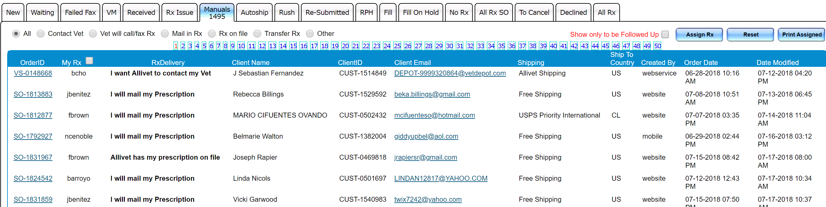
RX Manager
Task Tabs
Manuals Tab
Notes:
Manuals: This tab is not meant to be a search tab, but more of a task tab. Here is where all the orders which need prescription authorizations will be located. These order are manually followed up on by the Customer Service agents.
Manuals are a daily task for many of the customer service agents.
This is where agents are charged with contacting both client and veterinary office to verify if an authorization has been submitted to us.
Some times this will mean you are contacting the client to see if they have mailed in a prescription
Some times this is relaying back information from either the vet office to the client or vice versa.
No matter what the situation or information may be, everything must be documented in the notes area of the RX Card.

Slide 83
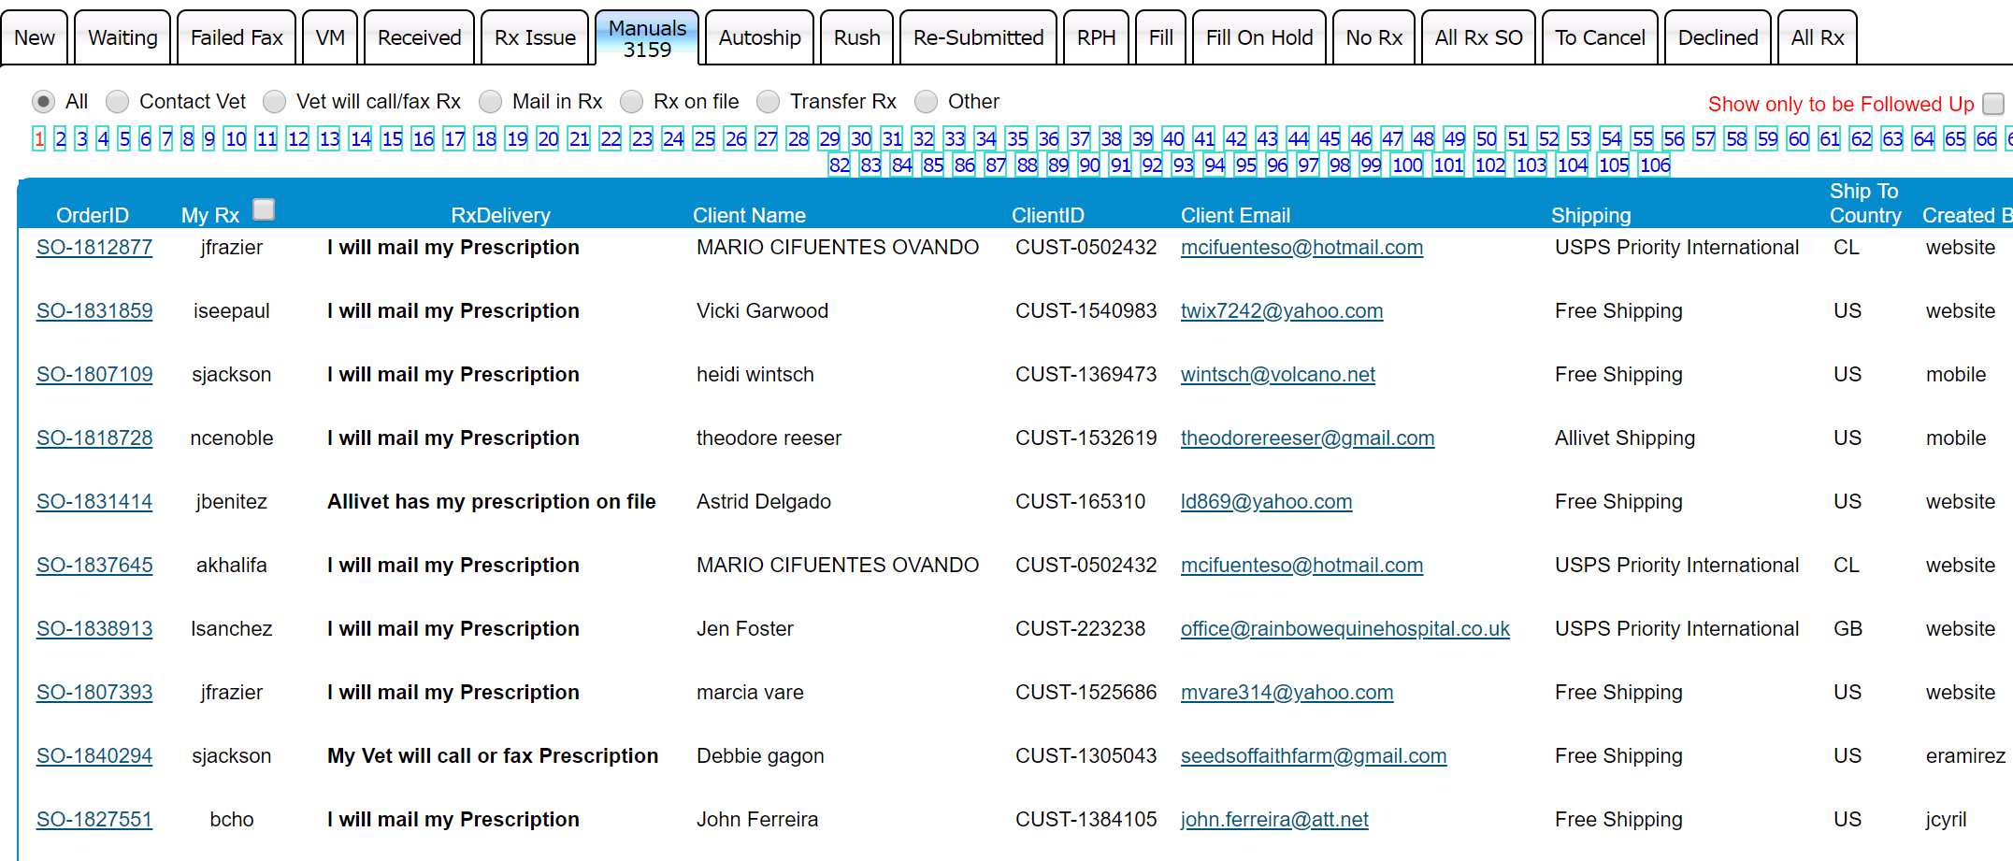

Rx Manager
Task Tabs
Manuals
Notes:
TRANSITION
When working within the “Manuals” tab, you want to be sure that you click on the “Show Only to be Followed Up On” button (Transition 1)
This will bring up only the orders that need current follow ups
Once reorganized you will want to start from the beginning by clicking on the order number (Transition 2)
This will take you into the order

Slide 84
Rx Manager
Task Tabs
Once in the order page you will want to enter the actual Rx Card by clicking on the hyperlink.
You will always want to first review the order from the Order Manager before entering the prescription.
This will allow you to verify how many Rx items are on the order, and how many need authorizations.
Notes:
TRANSITION
After reading first bullet point location will be highlighted

Slide 85
Rx Manager
Task Tabs
Notes:
TRANSITION
You always want to first asses the order in order to figure out a plan of action.
You will first look at the selection of how the customer wishes to get their RX to us (TRANSITION 1)
Then you want to see what if any the notes say regarding this order (Transition 2)
Last you want to see how many times this client has been contacted and how they were contacted (TRANSITION 3)

Slide 86
Rx Manager
Task Tabs
Notes:
TRANSITION
Now that you have assessed the order you will need to see what will be the best form of contact towards either the client or the vet.
In the above case the client has chosen to mail in the prescription
We notice that there are two previous attempts in obtaining the prescription.
On the third attempt or higher we will always want to contact both client and veterinarian office if the client chooses “I want Allivet to contact my vet” via phone.
After 3 manual attempts of contacting both client and vet you can place the order under Pending Cancellation
As this will be the third attempt of authorization we would typically select “phone” but what happens if they do not answer and we leave a voicemail, we can still send an email reminder to them as well.
So do you click on “PHONE” or “EMAIL”, or do you do both?
This will apply when you are sending a fax to the vet office, or an email to them. You will call and then click on fax if you can fax a reminder. And follow it with the notes that you left a vm and sent a fax/email to the office.
IF you need to contact the vet you will always call the client after to provide them with a telephoned update.
You will also need to note that you either spoke with the client or left them a vm with an update based on your vet notes.
You will only click on Email in order for the system to send an automated email to the client and you will make a note that you contacted the client and left a vm and also sent an email reminder.

Slide 87
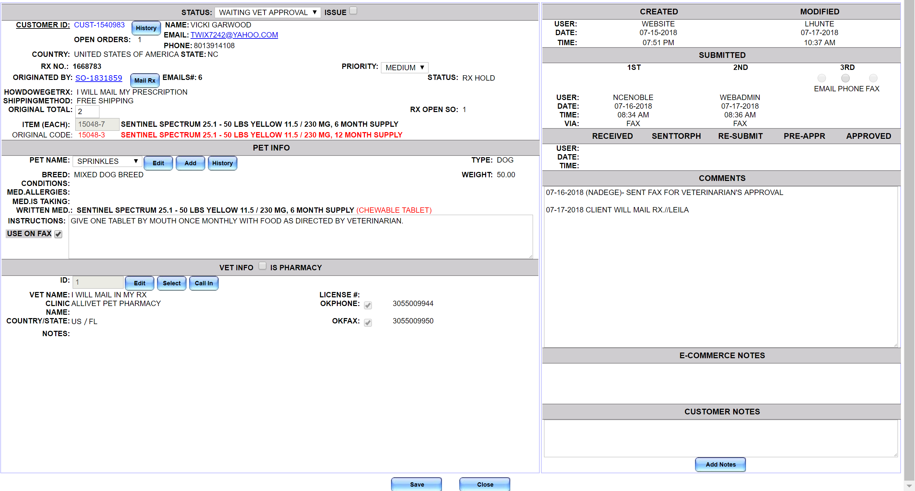
Rx Manager
Task Tabs
Notes:
TRANSITION
Make sure once you have finalized your notes, and you have made you selection of contact you click on the lower buttons “Save and Close” (Transition)
This will take you back into the order manager where you can click on the Next button on the bottom of the page and move on to the next one.

Slide 88
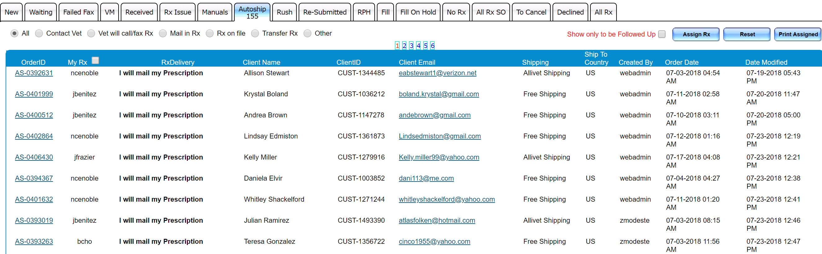
RX Manager
Task Tabs
Autoship Tab
Notes:
Autoship: This is another task tab, this tab has the same concept of the Manuals tab. The main difference is this tab is a high priority tab. As this tab holds all autoship orders that need prescription authorization.

Slide 89
Inventory Manager

Slide 90
Inventory Manager
Introduction
Inventory Manager is your key to verifying what is in currently in stock or what is coming in back into stock.
Identifying the difference between In Stock and Free Stock
See what orders have already been allocated
Verify the last time we made an order for the specified item
View EXP Dates
Notes:
Transition Arrow Indicating Inventory Manager Location

Slide 91
Inventory Manager
Inventory manager is presented as a table.
To search an item in the INVENTORY MANAGER, enter the item name or item code in the search bar and click on the blue “Search Item” button.

Slide 92

Inventory Manager
Notes:
TRANSITIONS
The inventory manage will break up into 3 separate areas
SECTION 1= Transition
The first section is a general overview of what we have in current stock and what we may have ordered
Free Stock
- This is the total amount of product that we have which has been unassigned to an order.
Qty. Alloc.
This reflects the number of items that have been pulled from the free stock and assigned to an order.
In Stock
How many we have in total stock
This includes what is allocated and what is in free stock
Waiting PO Qty
The qty of the order we have placed for this item
PO Date
The date this item was last ordered on.
Section 2 & 3= Transitions
The second and third sections are past batches that include
The date they were received
The Qty received
The EXP date

Slide 93
EXERCISE

Slide 94
Rx Manager
Exercise
In this exercise you will be reviewing prescriptions and answering to the following questions
Rx 1678131
How was this Rx received?
Rx 1462365
How many times did we contact the vet?
Rx 1675105
Why is this order on Fill On Hold?
Rx 2218001
How many refills did the veterinarian approve?

